Slide 1


Health REMINDER
Sinhgad Academy Of Engineering
Second year, Computer Department presenting
using python

Slide 2

Name of students : -
COSB17 Prerna Jitendra pakhale
COSB21 Anurag Abhay Pargaonkar
COSB24 Ishant Rajesh Patil
COSB49 Shrihari Sharad Shinde
COSB62 Aditi Jaypal Umare

Slide 3
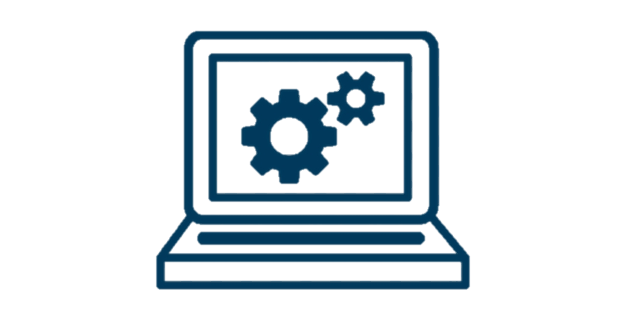
BASIC Idea of project : -
The category of patients involve all human beings-teachers, students, businessmen, housewives, children and also all of us have a busy hectic schedule. Today’s life is full of responsibilities and stress. So people are prone to diseases of different types and it is our duty to make ourselves stay fit and healthy. If the patient stays at home then he or she might get someone to look after him/her but when one is not at home, is out of the city or state away from home then it is hard for the family members to call them and remind them their dosage timings every time.
In our developing and technology dependent life we totally rely on gadgets especially smart phones. Today everyone has a smart phone. With this we get an opportunity to use technology in a better way so that it can be made useful to us. And it plays an important part in our daily life and helps us staying fit in many ways.

Slide 4
BASIC Idea of project : -
So we are introducing an System whose objective is to remind the patients of their dosage timings through a notification pop up so that they can stay fit and healthy. Through navigation they can search doctors and hospitals and contact details so that they can easily get proper treatment on time. This idea focusses on the people who forget to take medicines on time. It allows users to set an alarm along with the fields of date, time and medicine description which will allow them to set alarm for multiple medicines at different time intervals. The notification system will send a notification after setting an alarm.
The user can activate or deactivate the notification accordingly. The patients can search doctor disease wise and area wise which will provide easy searching facility along with doctor’s contact information, visiting place and availability time. Medication reminders help in decreasing medication dispensing errors and wrong dosages.

Slide 5
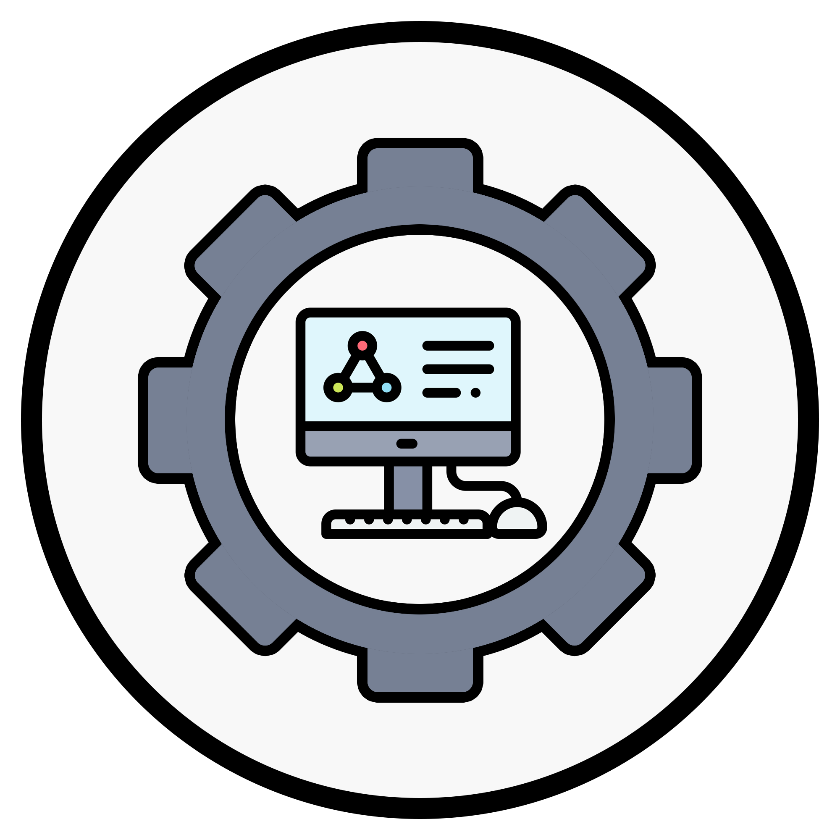
Problem / need in Daily life : -
Many Medication Systems have been developed based upon different platforms and concepts. Use of healthcare related apps is growing but there are many issues related to their functionality. A Medi-Health is a medication reminder system for children. It runs on mobile devices such as smart phones, providing user interfaces for configuring medication schedules and user alerts for reminding users about the time and type of medication according to the configured medication schedule. Some systems use sensors, radio-frequency identification (RFID), or motion detection technologies to ensure that patients actually take their medications. Park et al proposed medication reminder synchronization system based on data synchronization. It transmits OMA (open mobile alliance) DS (data synchronization) based messages containing the patient’s medication data and the device configuration data to a remote manager/medical staff. It also synchronizes data (including medication schedules) modified/generated by these personnel in the medication server.

Slide 6
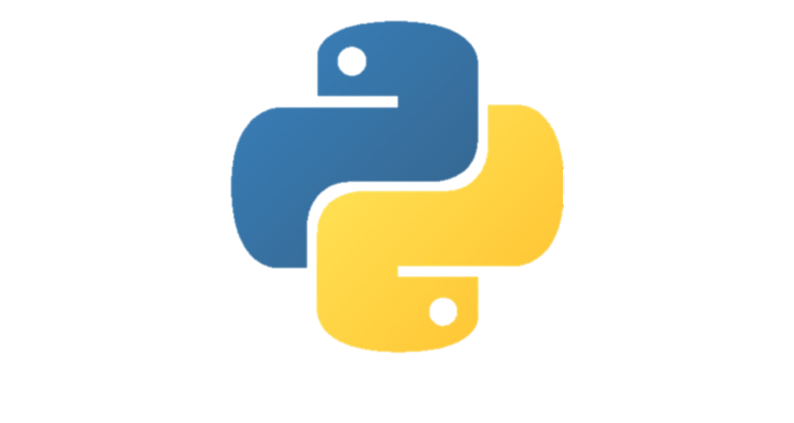
WHY python ?
Python is Handy for Web Development Purposes
According to expert professional web developers, Python is among the most convenient programming languages among the other alternatives. Due to the availability of its vast range of applications with in-built solutions to standard web development tasks, the speed of a single project increases by many times.
Has Multiple Libraries and Frameworks
Python is quite popular due to its hundreds of different libraries and frameworks that can be used by developers. These libraries and frameworks are really useful in saving time which in turn makes the language even more useful. Some of the most popular libraries available in Python are NumPy and SciPy, Django, and others that are used for different purposes.

Slide 7
WHY python ?
Flexibility and Reliability
The Python language is flexible enough to provide developers with ample time to try new experiments. Python experts will not just stop at the usual things, instead, they will try to build new processes, technologies, or applications. It provides the developers with the freedom and flexibility that they need to just learn one language and utilize their best potential and skills.
Python Automates Tasks
Python language can help automate several industrial tasks that require too many tools and modules. It is incredible to know that one can reach an advanced level of automation easily by just using necessary Python codes. The language is considered a performance booster in automation software testing. The developers only need to write a few lines of code for automation tools.

Slide 8
Need for health reminder
Medicine on
time
Drinking
water
Take
rest

Slide 9
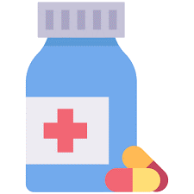

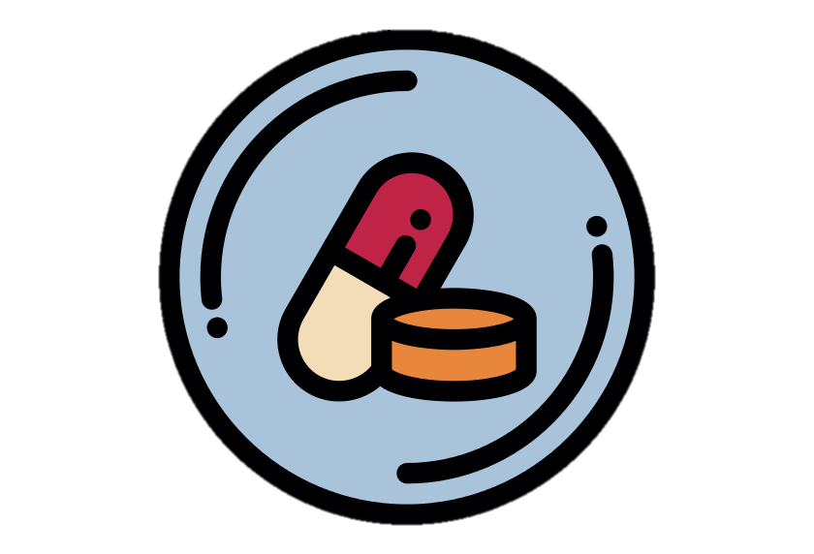
Medicine on time is important : -
Taking medicine on time, as prescribed, is essential to making sure your body has an effective amount of the drug at all times.
If not, this can cause the disease to develop a resistance to the medicine or simply prolong the amount of time it takes to feel better.
Having enough medicine in your body at all times is crucial in the recovery process, and the best way to do that is by taking your medications at the correct times every day. Following these tips will help make you feel better faster.
The Centers for Disease Control and Prevention estimates that not taking medicine on time accounts for up to 50 percent of disease treatment failure. If you are unsure of when you should be taking a medication, ask your doctor.

Slide 10
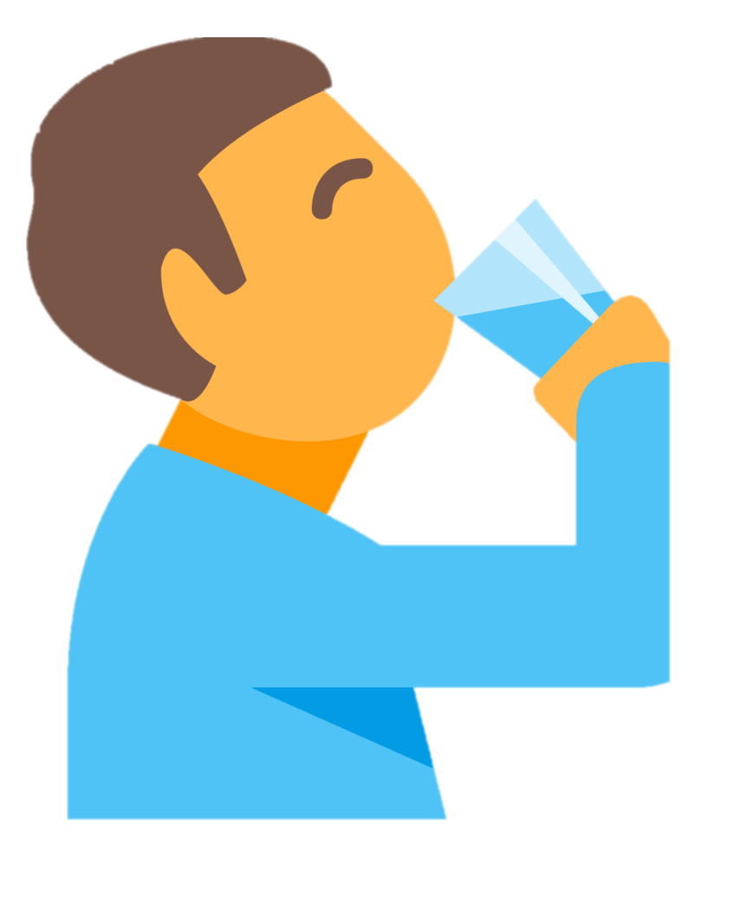
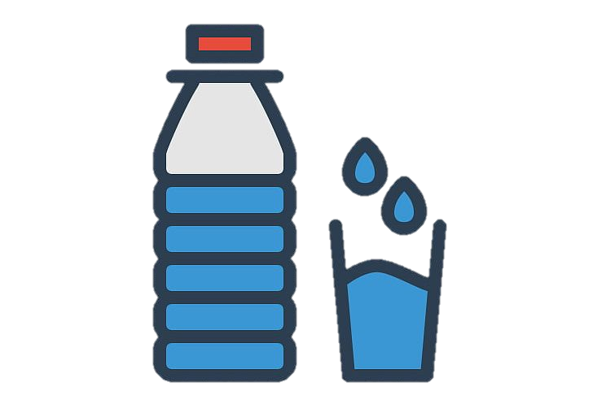
Drinking water regularly : -
Drinking water can prevent dehydration, a condition that can cause unclear thinking, result in mood change, cause your body to overheat, and lead to constipation and kidney stones.
Water helps your body: Keep a normal temperature. Lubricate and cushion joints.
Keep a normal temperature , Lubricate and cushion joints.
Protect your spinal cord and other sensitive tissues. Get rid of wastes through urination, perspiration, and bowel movements.
Drinking Water Helps Maintain the Balance of Body Fluids And Helps to Control Calories.
Water Helps Energize Muscles & Helps Keep Skin Looking Good.
About 15.5 cups (3.7 liters) of fluids a day for men. About 11.5 cups (2.7 liters) of fluids a day for women.

Slide 11
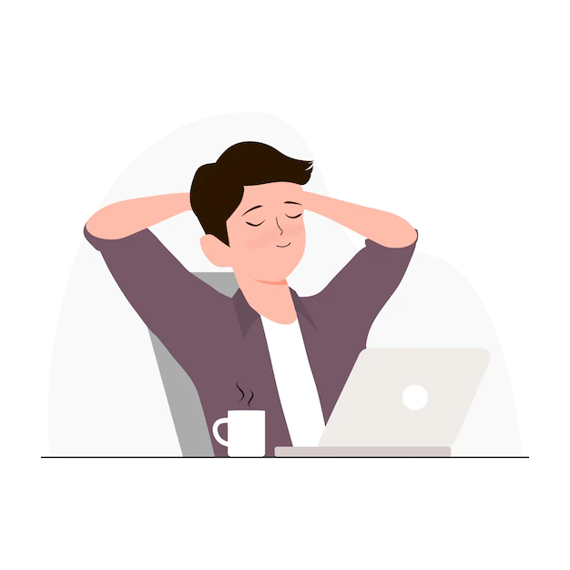

Taking rest/break during continues work : -
Every 30 to 60 minutes, take a brief rest break. During this break, stand up, move around, and do something else.
The body is designed to respond to short bursts of stress. When stress is prolonged and the stress response is triggered repeatedly and regularly as can happen in a stressful job or a conflict-ridden relationship the situation turns into one of chronic stress, and real health problems can set in.
Chronic stress may make you more susceptible to conditions ranging from frequent headaches and gastrointestinal issues to high blood pressure, which brings an increased risk of heart disease and stroke. When your "allostatic load," or overall level of stress, accumulates to a certain level, stress can snowball because you're constantly in a state of reactivity.
Advantage of taking rest :-
  Breaks help you to process and retain information
  You’ll get a better sense of the bigger picture
  You’ll be more creative
  Breaks can help you cultivate healthier habits
  Taking regular breaks helps you be more productive

Slide 12
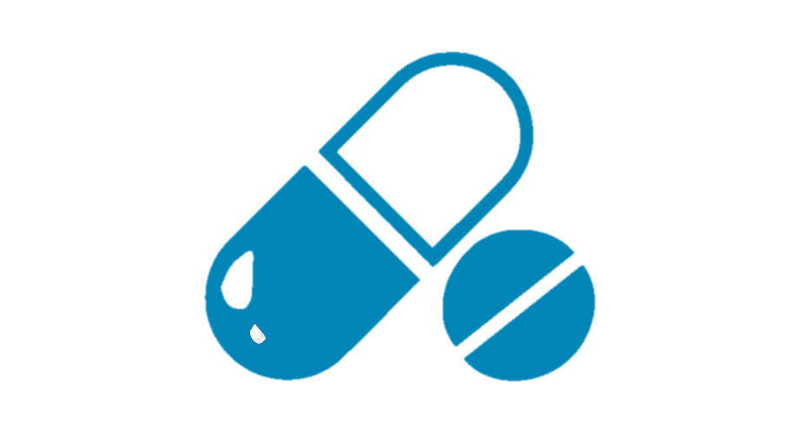
Working : -
FOR MEDICINE REMINDER : -
Medicine name
Calculating Data in proper order
Display pop up Notification
If True
Medicine timing

Slide 13
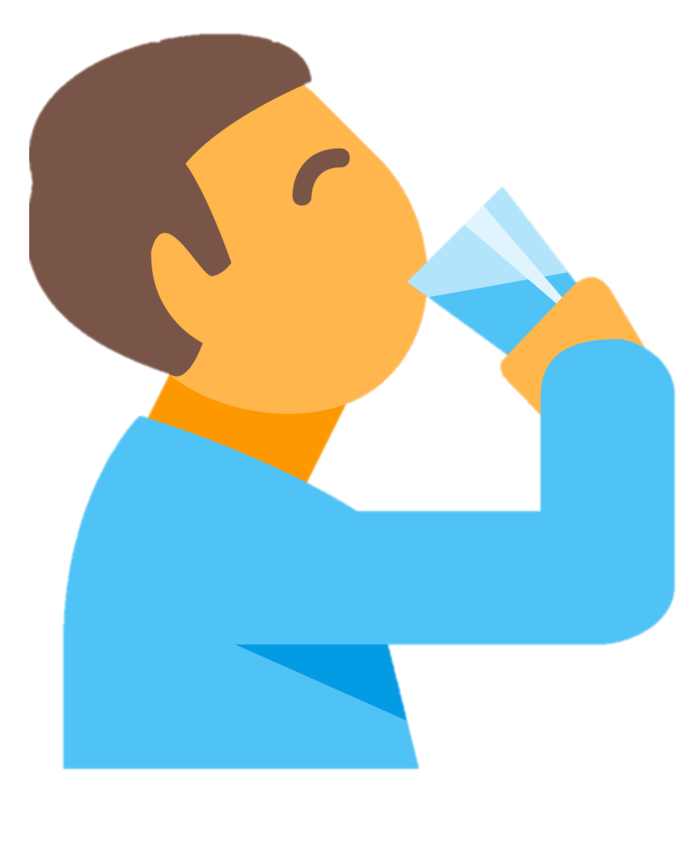
Working : -
FOR Water REMINDER : -
Pop up notification for cup of water
After Every 45 min

Slide 14
Working : -
Rest / Break REMINDER : -
Pop up notification for walk
Pop up notification of exercise
5 min
5 min
Continue working for 30 - 60 min
2 min
Pop up notification for mind relax

Slide 15
WHAT’s New / next : -
It supports an easy implementation as it is less expensive, reliable, scalable, accessible to anyone with smartphones, and do not require separate devices, packaging or extra hardware. In case if the users phone is switched off and he has set the alarm and the notification is set on , still he will be able to get the notifications through email or message.
We have try to implement a navigation system which will allow users to locate the nearest registered hospitals according to their current location. The location based searching of the doctors as well as disease wise searching has been focused which makes the application more suitable, more user friendly with great features and satisfactory results.

Slide 16
SCOPE IN MARKET : -
Many Medication Reminder Systems have been developed on different platforms. Many of these systems require special hardware devices to remind the patients about the medicine intake timings. Purchasing new hardware devices becomes costly and more time and money consuming. So in the given work an attempt has been made to implement a system which is economical, easily accessible and improves medication adherence. Medication non-adherence reduces the effectiveness of a treatment and imposes a financial burden on health care systems.
The user will get the schedule of medicine in-take time with medicine description, starting and ending date of medicine, notification through message or email, automatic alarm ringing system and navigation system.

Slide 17
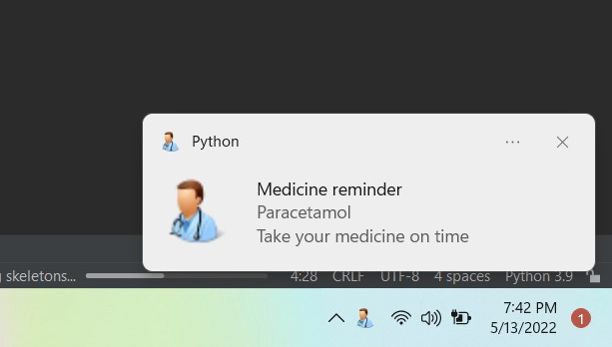
IMPLEMENTATION & RESULT: -
Notification pop up for
medicine

Slide 18
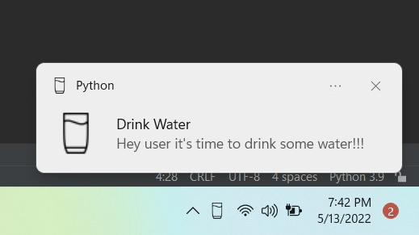
IMPLEMENTATION & RESULT: -
Notification pop up for
Water

Slide 19
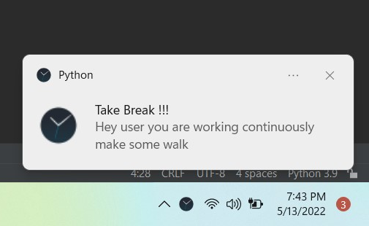
IMPLEMENTATION & RESULT: -
Notification pop up for
Break

Slide 20

IMPORTAN CONTENT
CODE file :
https://goonlinetools.com/snapshot/code/#39qbq1ayo0aem03h0vt8yo
Report file :
https://docs.google.com/document/d/1l42algajRICBniJy-obqtyTq0cyzTapRr0HaTVjCEAc/edit?usp=sharing

Slide 21


HEALTH REMINDER
TEAM

